Slide 1
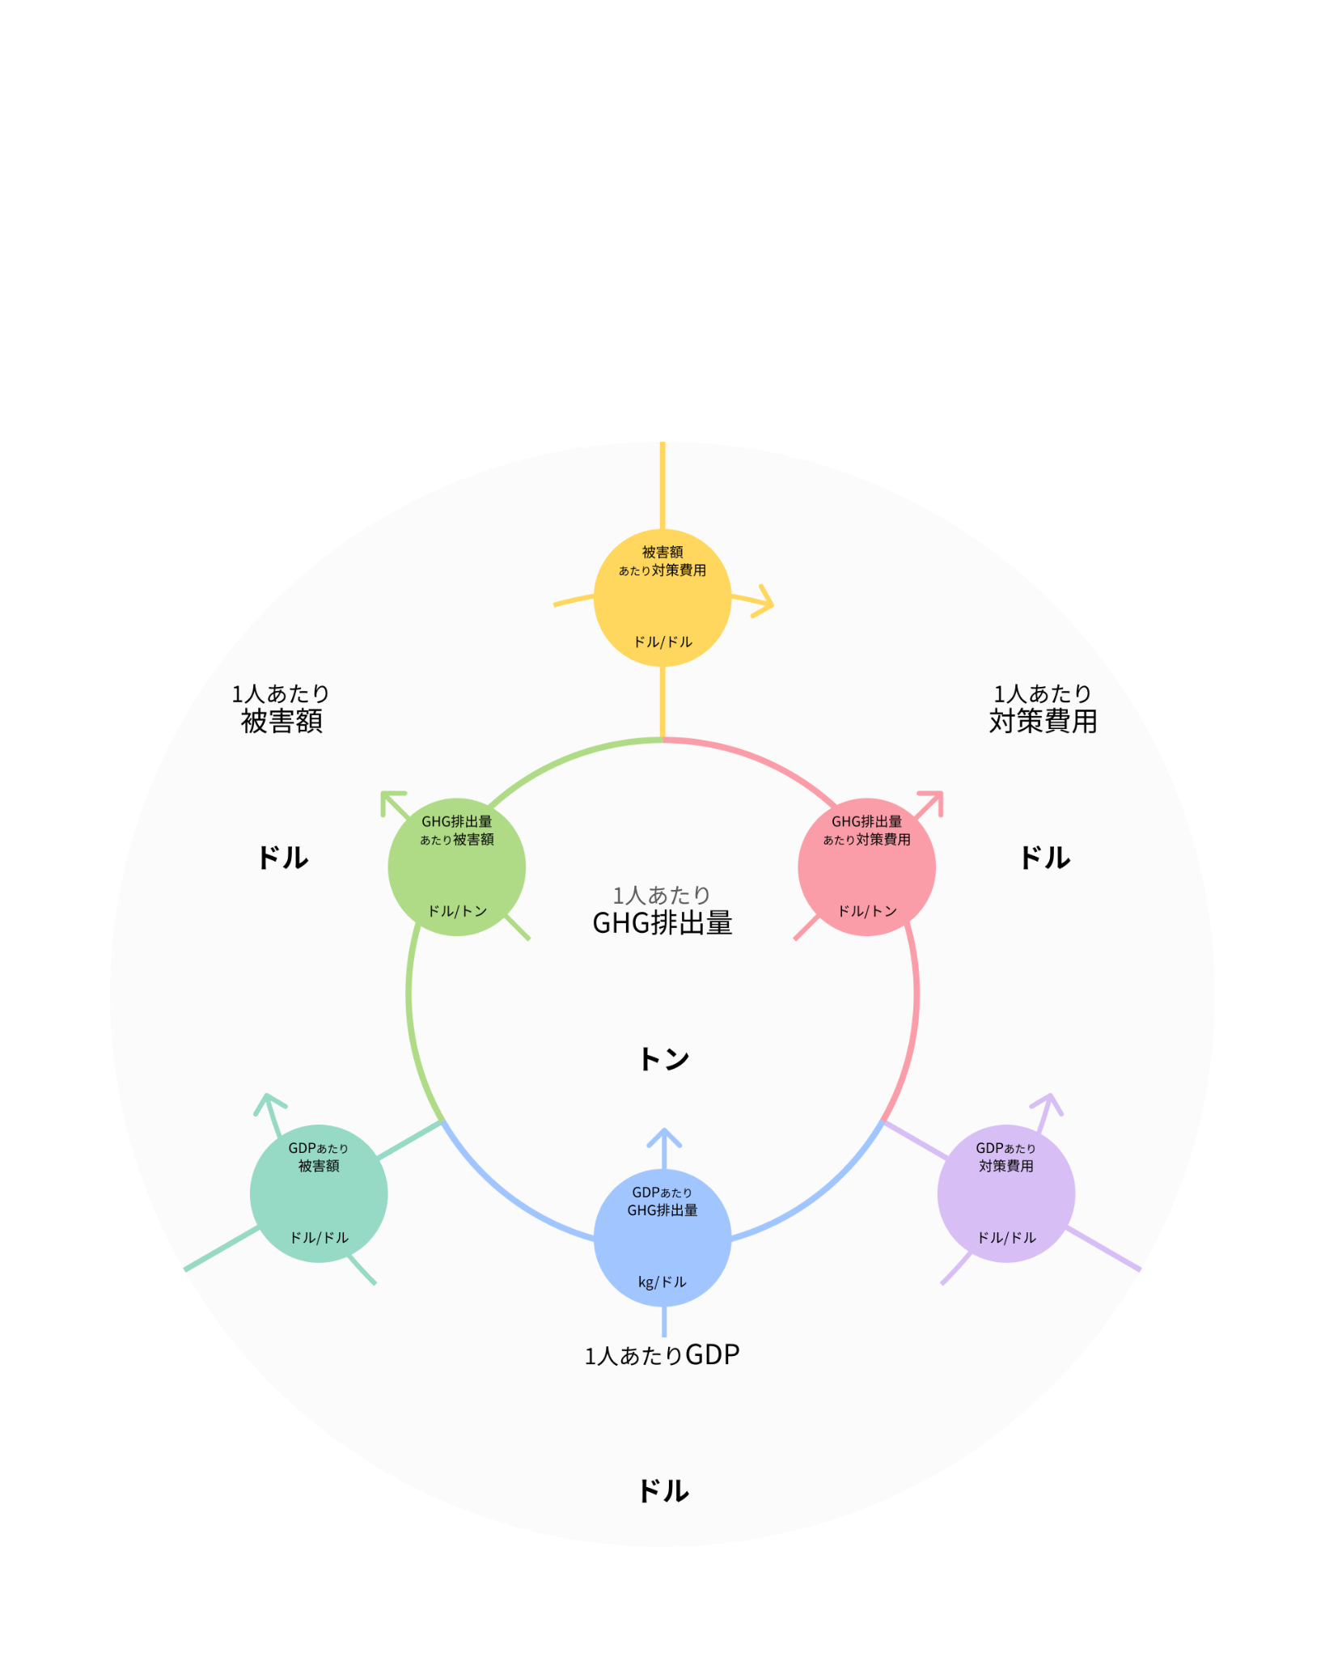
シナリオ
YEAR-YEAR
国名
×0.00
10
10
×0.00
×0.00
10,000
×0.00%
×0.00%
×0.00
10,000

